Slide 1
“Everything fails all the time”

Slide 2










Avoid single points of failure.
4
Thursday, November 21, 13

Slide 3
Elastic Load Balancing and Amazon Route 53 are
critical components when building scalable and
highly-available applications.
5

Slide 4






















Load Balancer
Elastic
Secure
Integrated
Cost-Effective
[ What is Elastic Load Balancing? ]
6

Slide 5



































Availability Zone 1a
EC2 Instances
EC2 Instances
Elastic
Load Balancing
Elastic
Load Balancing
(Internal)
Client
EC2 Instances
EC2 Instances
Availability Zone 1b
[ What is Elastic Load Balancing? ]
7

Slide 6
3
Levels
of
Availability
7
Thursday, November 21, 13

Slide 7


1
Instance
Availability
8
Thursday, November 21, 13

Slide 8


1
2
Instance
Availability
Zonal
Availability
8
Thursday, November 21, 13

Slide 9

1
2
3
Instance
Availability
Zonal
Availability
Regional
Availability
8
Thursday, November 21, 13

Slide 10

1
Instance
Availability
9
Thursday, November 21, 13

Slide 11
First step in increasing the availability
of a system or application.
10

Slide 12


Load balancer used to
route incoming
requests to multiple
EC2 Instance
EC2 instances
Client
[ Instance Redundancy ]
12
Thursday, November 21, 13

Slide 13






EC2 Instance
Load balancer used to
route incoming
Elastic
Load Balancing
requests to multiple
EC2 Instance
EC2 instances
Client
EC2 Instance
[ Instance Redundancy ]
13
Thursday, November 21, 13

Slide 14
Incoming request load shared
by all instances behind the load balancer.
13
Thursday, November 21, 13

Slide 15



EC2 Instance
Elastic
Load Balancing
Leastconns used to spread
request across healthy
instances
EC2 Instance
Client
EC2 Instance
[ Request Routing ]
15
Thursday, November 21, 13

Slide 16

EQUAL UTILIZATION
ON EACH INSTANCE
EC2 Instance
Elastic
Load Balancing
Leastconns used to spread
request across healthy
instances
EC2 Instance
Client
EC2 Instance
[ Request Routing ]
15
Thursday, November 21, 13

Slide 17





EQUAL UTILIZATION
TARGETS INSTANCES WITH
ON EACH INSTANCE
FEWEST OUTSTANDING REQUESTS
EC2 Instance
Leastconns
Elastic
Load Balancing
Leastconns used to spread
request across healthy
instances
EC2 Instance
Client
ADJUSTS TO REQUEST
SMOOTHS REQUEST LOAD
RESPONSE TIMES
ACROSS ALL INSTANCES
EC2 Instance
[ Request Routing ]
15
Thursday, November 21, 13

Slide 18
Instances that fail can be replaced seamlessly
while other instances continue to operate.
15
Thursday, November 21, 13

Slide 19



EC2 Instance
Application level
Elastic
Load Balancing
health checks ensure that
request traffic is shifted
EC2 Instance
Client
away from a failed instance
EC2 Instance
[ Health Checks ]
17
Thursday, November 21, 13

Slide 20


FAILURE DETECTED
X
EC2 Instance
Application level
Elastic
Load Balancing
health checks ensure that
request traffic is shifted
EC2 Instance
Client
away from a failed instance
EC2 Instance
[ Health Checks ]
17
Thursday, November 21, 13

Slide 21

TRAFFIC SHIFTED
FAILURE DETECTED
X
X
EC2 Instance
Application level
Elastic
Load Balancing
health checks ensure that
request traffic is shifted
EC2 Instance
Client
away from a failed instance
EC2 Instance
[ Health Checks ]
17
Thursday, November 21, 13

Slide 22

TRAFFIC SHIFTED
FAILURE DETECTED
X
X
EC2 Instance
Application level
Elastic
Load Balancing
health checks ensure that
request traffic is shifted
EC2 Instance
Client
away from a failed instance
EC2 Instance
HEALTHY INSTANCES CARRY
ADDITIONAL REQUEST LOAD
[ Health Checks ]
17
Thursday, November 21, 13

Slide 23






TRAFFIC SHIFTED
FAILURE DETECTED
USED TO DETERMINE THE HEALTH OF
X
THE INSTANCE AND APPLICATION
X
TCP AND HTTP
EC2 Instance
Application level
health checks
Elastic
Load Balancing
health checks ensure that
request traffic is shifted
EC2 Instance
Client
away from a failed instance
CONSIDER THE DEPTH AND
CUSTOMIZE
FREQUENCY
ACCURACY OF YOUR
AND
FAILURE THRESHOLDS
EC2 Instance
HEALTHY INSTANCES CARRY
HEALTH CHECKS
ADDITIONAL REQUEST LOAD
[ Health Checks ]
503 ERRORS RETURNED IF
NO HEALTHY INSTANCES
17
Thursday, November 21, 13

Slide 24

Auto Scaling can be used to automatically adjust
instance capacity up or down depending on
conditions you define.
18
Thursday, November 21, 13

Slide 25









Elastic
Load Balancing
EC2 Instance
EC2 Instance
EC2 Instance
[ ELB & Auto Scaling ]
19
Thursday, November 21, 13

Slide 26






Elastic
Load Balancing
EC2 Instance
EC2 Instance
EC2 Instance
[ ELB & Auto Scaling ]
LOAD INCREASES
19
Thursday, November 21, 13

Slide 27












INSTANCES ADDED FOR
Elastic
Load Balancing
INCREASED LOAD
EC2 Instance
EC2 Instance
EC2 Instance
EC2 Instance
EC2 Instance
[ ELB & Auto Scaling ]
19
Thursday, November 21, 13

Slide 28






Elastic
Load Balancing
EC2 Instance
EC2 Instance
EC2 Instance
EC2 Instance
EC2 Instance
LOAD DECREASES
[ ELB & Auto Scaling ]
19
Thursday, November 21, 13

Slide 29


Elastic
Load Balancing
INSTANCES REMOVED
AS LOAD DECREASES
EC2 Instance
EC2 Instance
EC2 Instance
[ ELB & Auto Scaling ]
19
Thursday, November 21, 13

Slide 30






Elastic
Load Balancing
INSTANCES REMOVED
AS LOAD DECREASES
AUTOMATICALLY SCALES
INSTANCES UP OR DOWN
CUSTOM SCALING METRICS
REDUCES COSTS
EC2 Instance
EC2 Instance
EC2 Instance
AUTOMATICALLY REPLACES
FAILED INSTANCES
[ ELB & Auto Scaling ]
Auto Scaling
19
Thursday, November 21, 13

Slide 31

2
Zonal
Availability
19
Thursday, November 21, 13

Slide 32


Availability Zones are distinct geographical
locations that are engineered to be insulated from
failures in other zones.
20
Thursday, November 21, 13

Slide 33


Region
Availability Zone
21
Thursday, November 21, 13

Slide 34

It is important to run application
stacks in more than one zone.
22
Thursday, November 21, 13

Slide 35

Avoid unnecessary dependencies
between zones.
23
Thursday, November 21, 13

Slide 36













Zone 1a
EC2 Instances
Load balancer used to
balance across instances in
multiple Availability Zones.
Elastic
Load Balancing
Client
EC2 Instances
Zone 1b
[ Availability Zone Redundancy ]
25
Thursday, November 21, 13

Slide 37
Each load balancer will contain one or more
DNS records, one for each load balancer node.
25
Thursday, November 21, 13

Slide 38























Client
192.0.2.1
Elastic
Load Balancing
192.0.2.2
EC2 Instance
EC2 Instance
EC2 Instance
EC2 Instance
EC2 Instance
EC2 Instance
[ Understanding DNS ]
27
Thursday, November 21, 13

Slide 39




Client
192.0.2.1
Elastic
Load Balancing
192.0.2.2
DNS ROUND ROBIN USED TO
EXPECT DNS RECORDS
BALANCE TRAFFIC BETWEEN
TO CHANGE OVER TIME
AVAILABILITY ZONES
EC2 Instance
EC2 Instance
EC2 Instance
EC2 Instance
EC2 Instance
EC2 Instance
DNS
[ Understanding DNS ]
EACH LOAD BALANCER DOMAIN NAME
MAY CONTAIN MULTIPLE A RECORDS
27
Thursday, November 21, 13

Slide 40

Using multiple Availability Zones does
bring a few challenges.
27
Thursday, November 21, 13

Slide 41


Availability Zones may
see traffic imbalances
due to clients caching
DNS records.
requests / minute
time
[ Multiple Zone Challenges ]
28
Thursday, November 21, 13

Slide 42





Zone 1a
2
EC2 Instances
An unequal number of
instances per zone can
lead to over utilization of
instances in a zone.
Elastic
Load Balancer
Client
3
EC2 Instances
Zone 1b
[ Multiple Zone Challenges ]
30
Thursday, November 21, 13

Slide 43

Problem solved.
30
Thursday, November 21, 13

Slide 44
Cross-Zone Load Balancing distributes
traffic across all healthy instances,
regardless of Availability Zone.
31
Thursday, November 21, 13

Slide 45

Zone 1a
2
EC2 Instances
Effectively balances the
request load across all
instances behind the load
balancer.
Elastic
Load Balancing
Client
3
EC2 Instances
Zone 1b
[ Cross-Zone Load Balancing ]
33
Thursday, November 21, 13

Slide 46


Traffic is spread evenly
across each of the active
Availability Zones.
requests / minute
time
[ Cross-Zone Load Balancing ]
33
Thursday, November 21, 13

Slide 47







Availability Zones may
see traffic imbalances
due to clients caching
DNS records.
ELIMINATES IMBALANCES IN
NO BANDWIDTH CHARGE
INSTANCE UTILIZATION
requests / minute
FOR CROSS-ZONE TRAFFIC
REDUCES IMPACT OF CLIENTS
REQUESTS DISTRIBUTED EQUALLY TO
CACHING DNS RECORDS
ALL INSTANCES REGARDLESS OF ZONE
time
Cross-Zone Load Balancing
[ Cross-Zone Load Balancing ]
33
Thursday, November 21, 13

Slide 48

3
Regional
Redundancy
35
Thursday, November 21, 13

Slide 49

Elastic Load Balancing and Amazon Route 53 have
been integrated to support a single application
across multiple regions.
36
Thursday, November 21, 13

Slide 50


Region
Availability Zone
37
Thursday, November 21, 13

Slide 51


• AWS’s authoritative Domain Name Service (DNS)
ROUTE
53
• Health checking service
•
Highly available and scalable
•
Offers tools that provide flexible, high-performance, and
highly available architectures on AWS
[ What is Amazon Route 53? ]
39
Thursday, November 21, 13

Slide 52


Improves availability by …
ROUTE
53
•
health checking load balancer nodes and rerouting
traffic to avoid failures
•
supporting multi-region and backup architectures for
high-availability
[ What is Amazon Route 53? ]
40
Thursday, November 21, 13

Slide 53

+
Health Checks
Failover
Automated requests sent over the
Internet to your application to verify
that your application is reachable,
available, and functional.
Only returns answers for resources
that are healthy and reachable from
the outside world, so end users are
routed away a failed application.
[ What is DNS failover? ]
40
Thursday, November 21, 13

Slide 54





Work on Failure
Constant Work
System activity
System activity
Time to react
Time to react
time
time
When nothing is failing, volume of API
Health checkers and edge locations
calls is zero. When failure occurs,
perform the same volume of activity
volume of API calls spikes.
whether endpoints are healthy or
unhealthy.
[ How does it work? ]
41
Thursday, November 21, 13

Slide 55


Amazon Route 53
conducts health checks
from within each AWS
region
[ Global Health Check Network ]
43
Thursday, November 21, 13

Slide 56

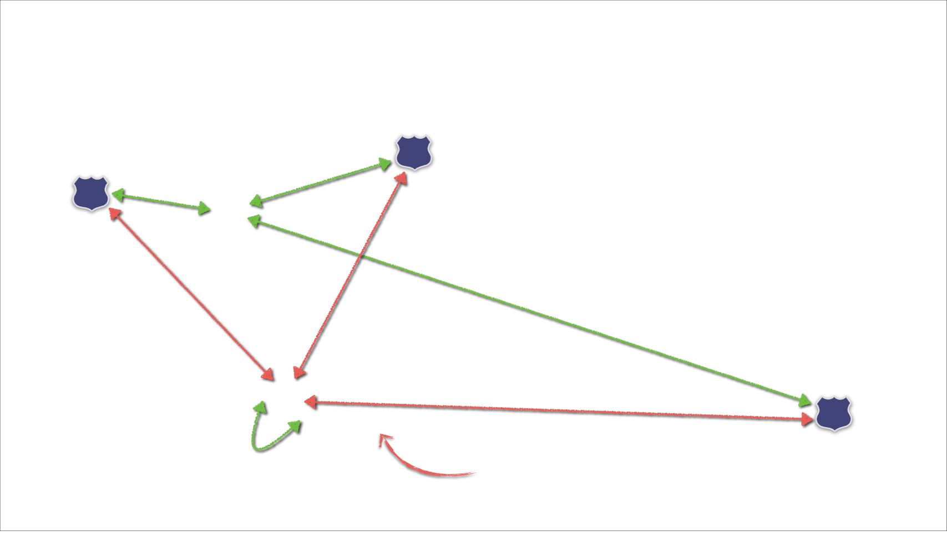







NETWORK PARTITION
43
Thursday, November 21, 13

Slide 57
150
MANUAL FAILOVER
•
•
operator receives an alarm
operator manually
configures DNS update
wait for DNS changes to
propagate
vs.
SECONDS
•
[ How does it work? ]
44
Thursday, November 21, 13

Slide 58




NO CONTROL PLANE INVOLVEMENT
150
150
REQUIRED FOR FAILOVER TO OCCUR
MANUAL FAILOVER
•
•
operator receives an alarm
operator manually
configures DNS update
wait for DNS changes to
propagate
vs.
EDGE LOCATIONS PULL HEALTH RESULTS
DIRECTLY FROM GLOBALLY DISTRIBUTED
SECONDS
SECONDS
HEALTH CHECKER FLEET
•
DON’T HAVE TO WAIT FOR API REQUESTS
TO SUCCEED AND THEN PROPAGATE
[ How does it work? ]
FAILOVER HAPPENS ENTIRELY WITHIN
THE AMAZON ROUTE 53 DATA PLANE
44
Thursday, November 21, 13

Slide 59

















Region
•
E-commerce site: example.com
•
Running application stack in multiple Availability
Elastic
Load Balancing
Zones in a single AWS region
•
Wants a backup in case:
-
Own application goes down across multiple
Availability Zones
-
Some parts of the world experience
degraded connectivity to this AWS region
EC2 Instances
EC2 Instances
[ Simple Failover Scenario ]
46
Thursday, November 21, 13

Slide 60






















Region
Primary
ROUTE
Secondary
Elastic
Load Balancing
Health
Check
53
S3
EC2 Instances
EC2 Instances
[ Simple Failover Scenario ]
47
Thursday, November 21, 13

Slide 61




















Region
X
Primary
ROUTE
Secondary
Elastic
Load Balancing
Health
Check
53
S3
X
FAILOVER
HEALTH CHECK FAILS
EC2 Instances
EC2 Instances
[ Simple Failover Scenario ]
48
Thursday, November 21, 13

Slide 62
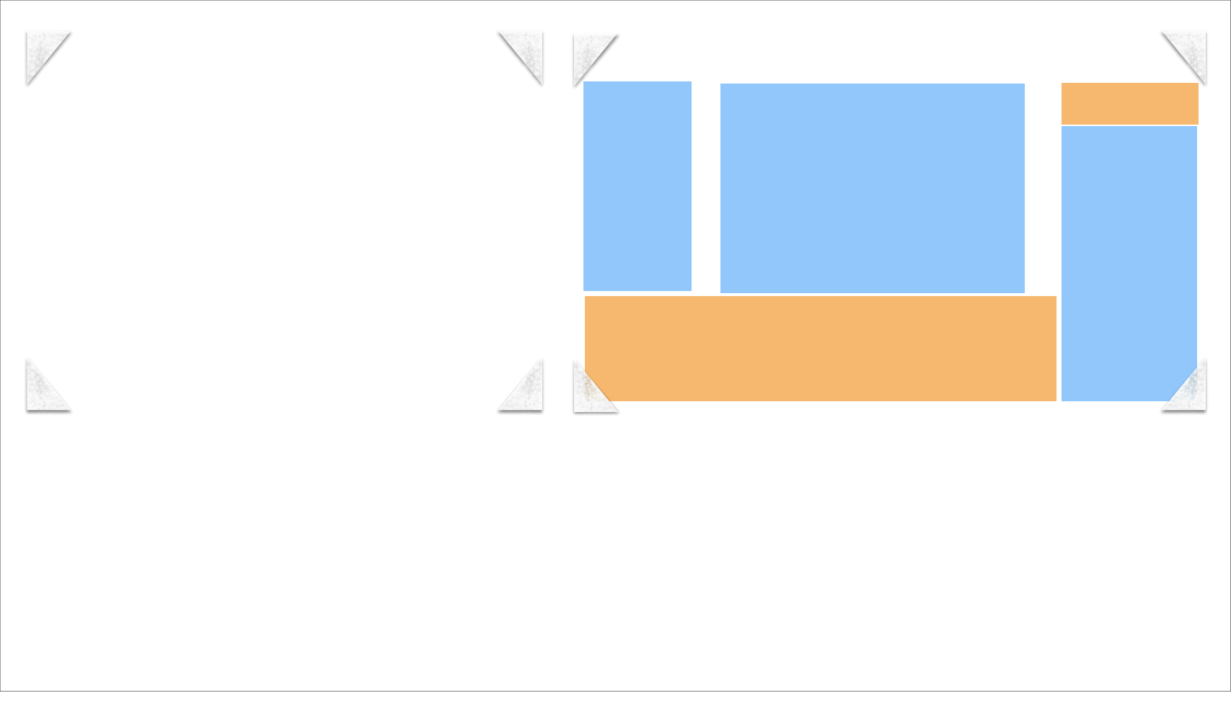




Static Site
Static vs. dynamic content
[ Static Backup Site Options ]
48
Thursday, November 21, 13

Slide 63

•
Provides your globally-distributed end users
with faster performance
•
Tag each destination end-point to the
Amazon EC2 region that it’s located in
•
Amazon Route 53 will route end users to the
end-point that provides the lowest latency
[ Latency Based Routing ]
50
Thursday, November 21, 13

Slide 64





•
Better performance than running in a single region
•
Improved reliability relative to running in one region
•
Easier implementation than traditional DNS solutions
“Our customers bid on video ad
inventory in real time and our system
must evaluate the content they're
sponsoring and respond with a
decision in less than 50ms, or they'll
lose the auction. Route 53’s Latency
Based Routing lets us easily run
multiple stacks of our whole targeting
platform in each AWS region so we can
meet our customers latency needs.”
•
Much lower prices than traditional DNS solutions
Jonathan Dodson,
Vice President of Engineering at Affine
[ LBR Benefits ]
50
Thursday, November 21, 13

Slide 65


































Region 1
Region 2
•
example.com wants faster
page load for customers
Elastic
Load Balancing
Elastic
Load Balancing
•
Launches application stack in
additional AWS regions
•
Uses Amazon Route 53
Latency Based Routing
•
Amazon Route 53 DNS
Failover ensures that end
users are only routed to a
region where the application is
EC2 Instances
EC2 Instances
EC2 Instances
EC2 Instances
healthy
[ Multi-Region Failover ]
52
Thursday, November 21, 13

Slide 66






























Region 1
Region 2
Primary
Primary
ROUTE
Elastic
Load Balancing
Health
Check
53
Health
Check
Elastic
Load Balancing
EC2 Instances
EC2 Instances
EC2 Instances
EC2 Instances
[ Multi-Region Failover ]
53
Thursday, November 21, 13

Slide 67


Region 1
Region 2
Primary
Primary
ROUTE
X
Elastic
Load Balancing
Health
Check
53
Health
Check
Elastic
Load Balancing
X
HEALTH CHECK FAILS AND
TRAFFIC SHIFTS AWAY
EC2 Instances
EC2 Instances
EC2 Instances
EC2 Instances
[ Multi-Region Failover ]
54
Thursday, November 21, 13

Slide 68






















Region 1
Region 2
Elastic
Load Balancing
Elastic
Load Balancing
S3
EC2 Instances
EC2 Instances
EC2 Instances
EC2 Instances
[ Multi-Region & S3 Failover ]
55
Thursday, November 21, 13

Slide 69
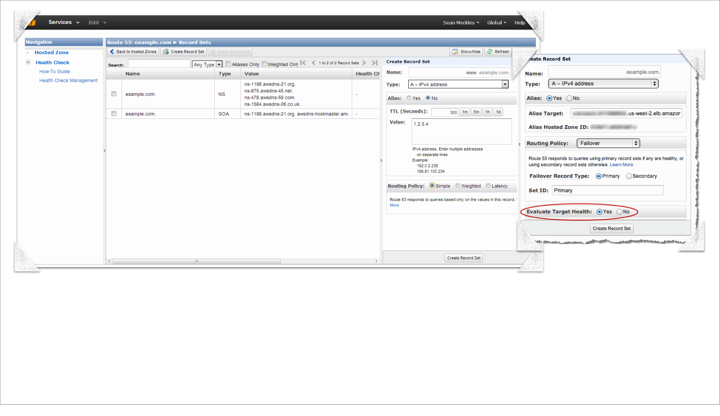
[ Configuring DNS Failover ]
56
Thursday, November 21, 13

Slide 70


3
Levels
of
Availability
67
Thursday, November 21, 13

Slide 71
1
Instance
Availability
68
Thursday, November 21, 13

Slide 72
1
2
Instance
Availability
Zonal
Availability
68
Thursday, November 21, 13

Slide 73
1
2
3
Instance
Availability
Zonal
Availability
Regional
Availability
68
Thursday, November 21, 13

